Slide 1
How many … are there?
What color are they?

Slide 2
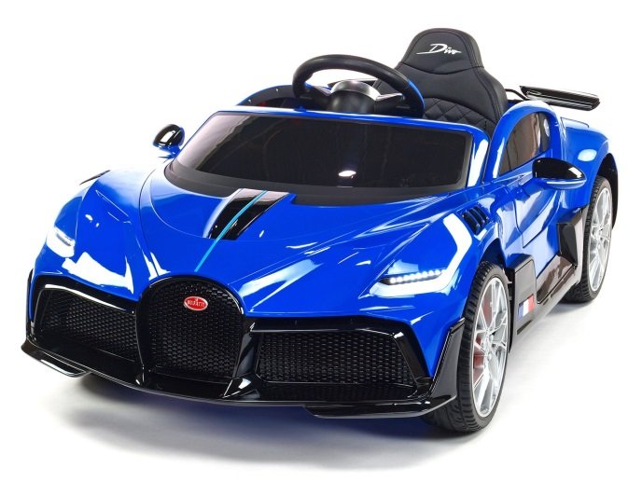

How many cars and what colors?
There are four blue cars.

Slide 3
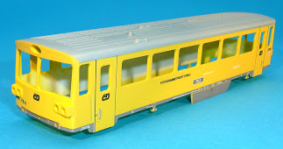
How many trains and what colors?
There are three yellow trains.

Slide 4
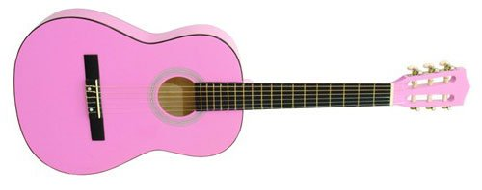
How many guitars and what colors?
There is one pink guitar.

Slide 5
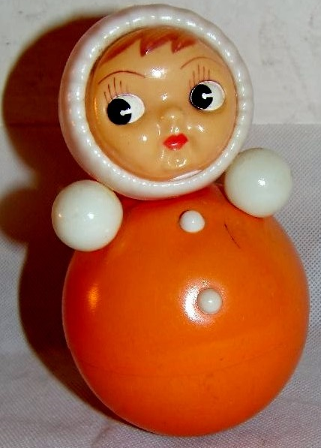
How many dolls and what colors?
There are seven orange dolls.

Slide 6
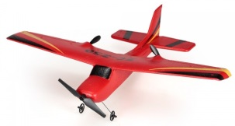
How many planes and what colors?
There are ten red planes.

Slide 7
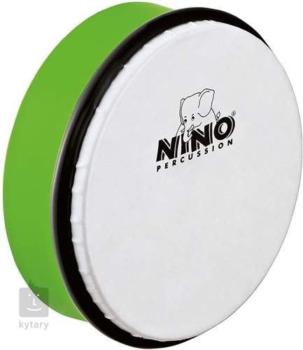
How many drums and what colors?
There are five green drums.

Slide 8
How much was there?
There are four blue cars. 4 modrá auta
There are three yellow trains. 3 žluté vlaky
There is one pink guitar. 1 růžová kytara
There are ten red planes. 10 červených letadel
There are seven orange dolls. 7 oranžových panenek
There are five green drums. 5 zelených bubnů

